Slide 1

LLS AUTOMATION DIVISION
MAKE TO STOCK WITH IN BUILD QA DATA CAPTURING ON WEB APPPLICATION

Slide 2
Application work flow
Employee
Master
Item Master
Planning
Assembly
Packing
Report
Admin
User 1
User 2
User 2
1) User Addition & Deletion
2) Control Rights of user
3) Work Flow approval -> BOM , QA Documents
4) FG & Dispatch Approval

Slide 3
Item Master
1
Item Code
Add | Delete | Edit
SNo | Type | Item Code | Description | Uom | Code | U_OperName | Assembly | Burn test | Packing | Image | Weight | Customer Complaint Information
 | BOM/ Part
2
BOM
SNo | Item Code | ChildCode | ChildName | BaseQty | Case No

Slide 4
Planning
Order Release
S.no | Work Order | Product | U_OperName | Item Code | Description | Qty | M/c No | Customer Name | Target date | Released By | Remarks
 |  |  | YBS |  |  | 500 | NA | NA
 |  |  | RSM |  |  |  | NA | NA
 |  |  | Panel |  |  |  | NA | NA
 |  |  | Packing |  |  | 1 | IYB001
Add | Delete | Edit

Slide 5
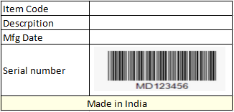
Assembly
No of Types
Serial Number
1) YBS- Y , RSM -R & Panel -P
2&3)Y Y - Year
4) Month (A- Jan,B-Feb,C-Mar ..... L- Dec
5) Code from Item master
6) Serial Number
If 5th digit code not available 0 can be placed
(Barcode Sticker -25 x 100)
YBS
9
RSM
6
Panel
Variables

Slide 6
Report
Scanning Report
Exisiting module with Serial number & rework details to be added
Planning Report
Query report of order release (Qty addition,deletion,release date,completion date)
QA Module Report
Query report of item master with change history
Packing Report
Query report of Packing work flow as like duct scanning report machinewise & Packing Summary
Production Details
Production details of U_OperName with first pass & rejection data day wise , month wise
Operator Log Sheet
Query report for operator day wise work sheet
Stock Report
1) Scanning completed parts should to take in stock report same should be consumed against the paking stage.
2) BOM Stock
Dispatch Report
FG & Dispatch details

Slide 7
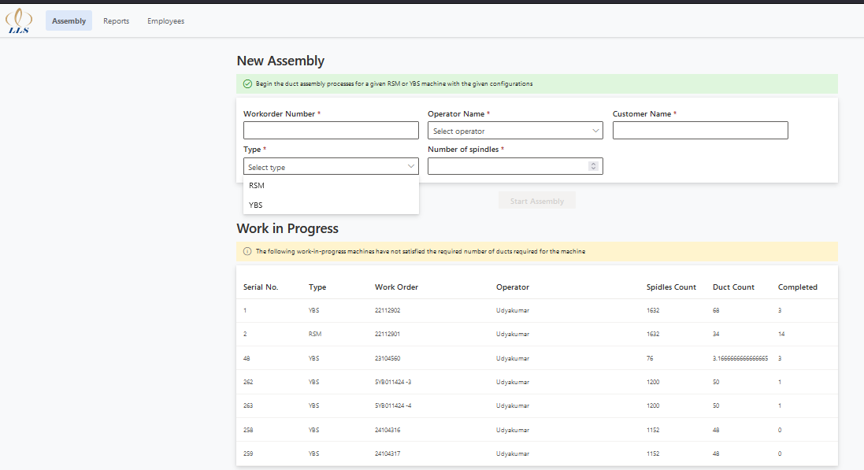
Existing screen & Flow
Input feeding based on Work order
Machine Type – YBS/RSM

Slide 8
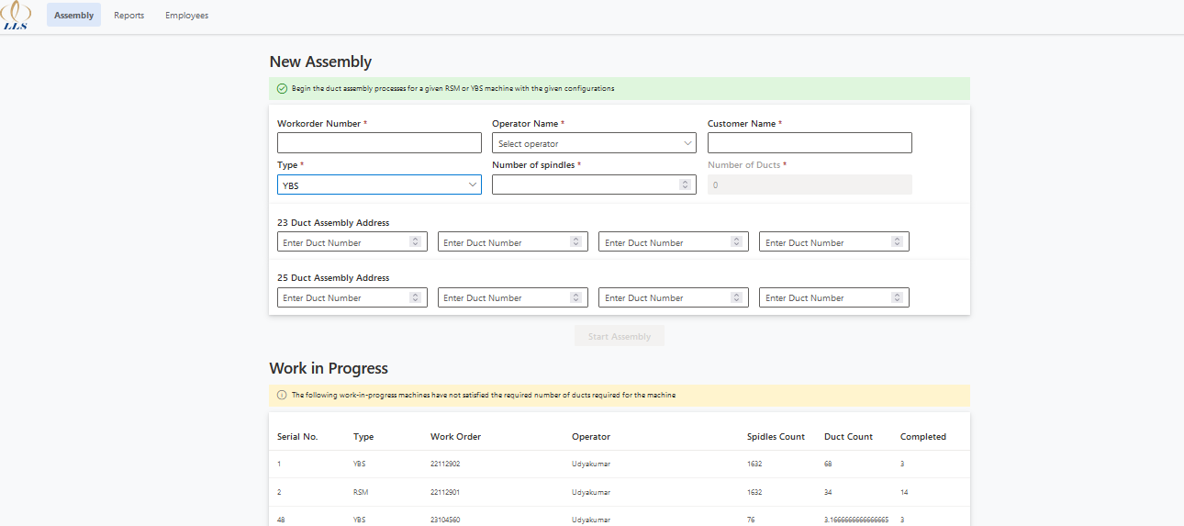
Existing screen & Flow
Duct address input based on T-flex
Work order selection for assembly scanning

Slide 9
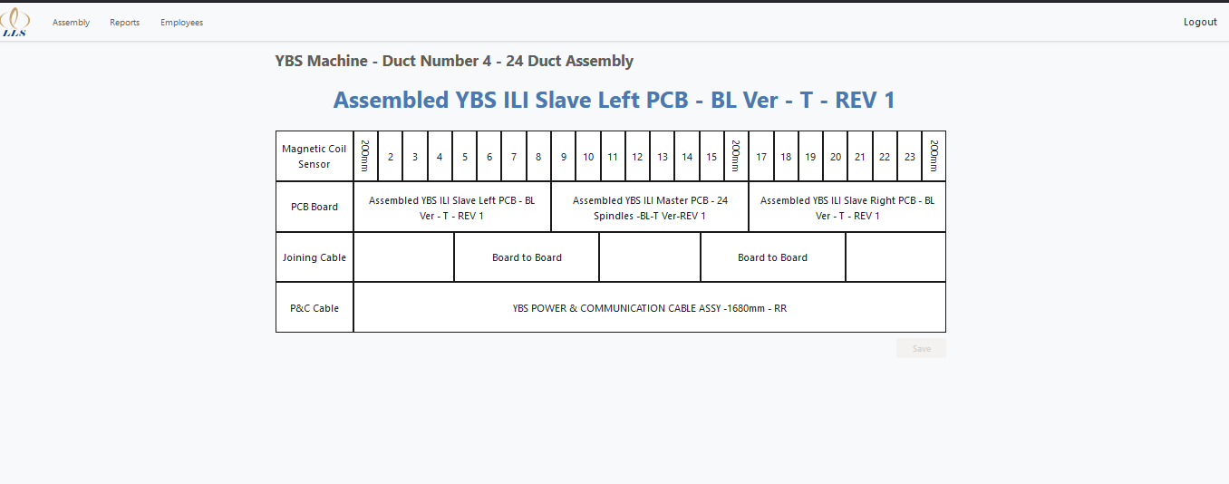
Existing screen & Flow
Assembly scanning screen YBS

Slide 10
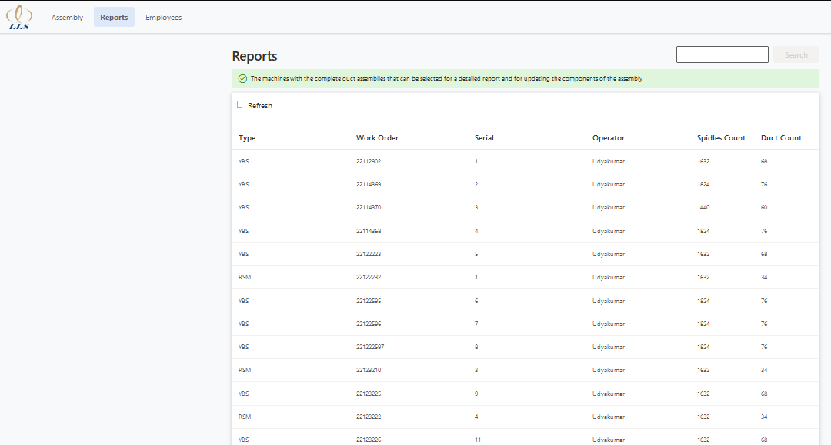
Existing screen & Flow
Displays the Completed Machines
By Clicking, it displays individual machine details

Slide 11
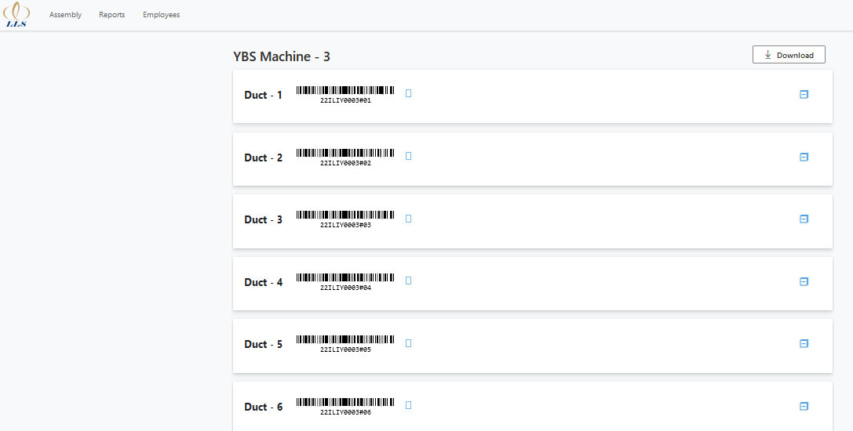
Existing screen & Flow
Individual Duct input record

Slide 12
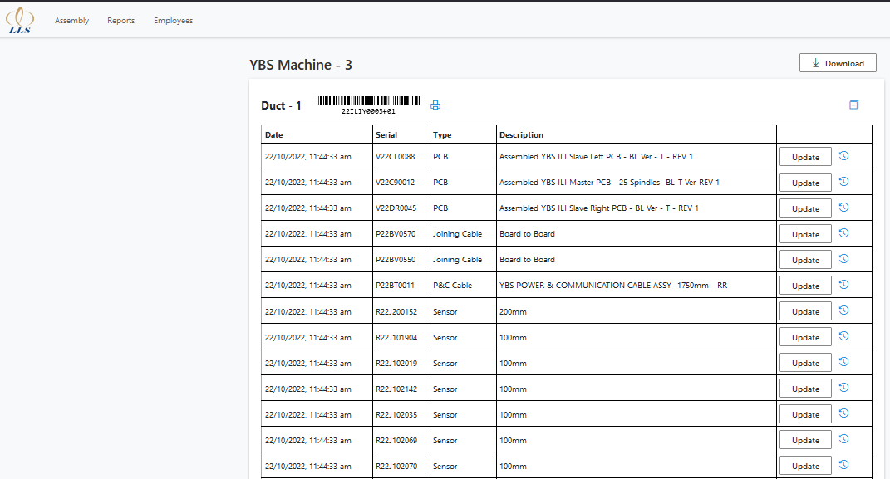
Existing screen & Flow
To replace the existing scanned parts, it should by accessed by admin only

Slide 13
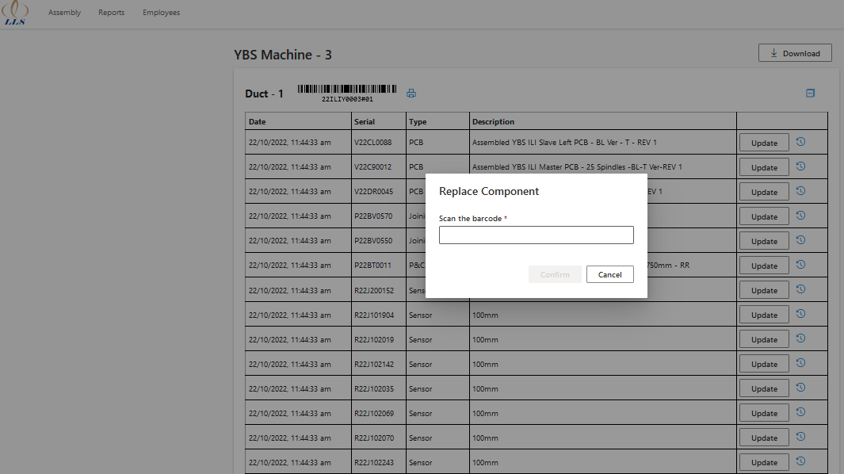
Existing screen & Flow
Replacement Screen

Slide 14
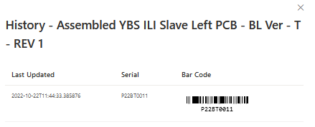
Existing screen & Flow
History of Scanned Part

Slide 15
Existing screen & Flow
It import the scanned details to Excel

Slide 16
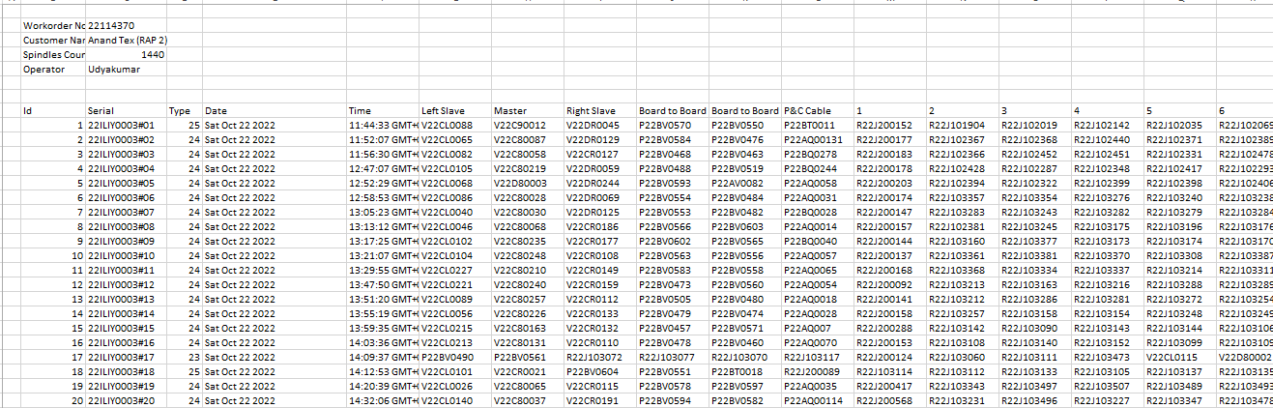
Existing screen & Flow
Imported details

Slide 17
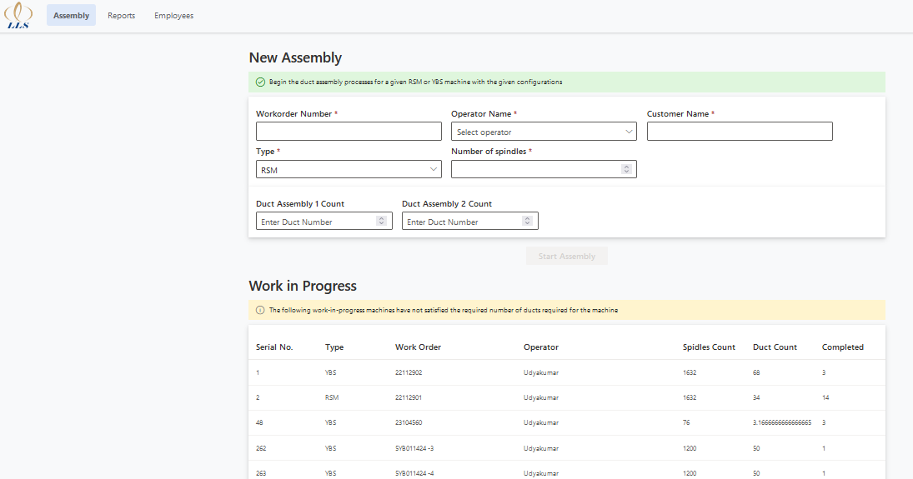
Existing screen & Flow
Work order selection for assembly scanning

Slide 18
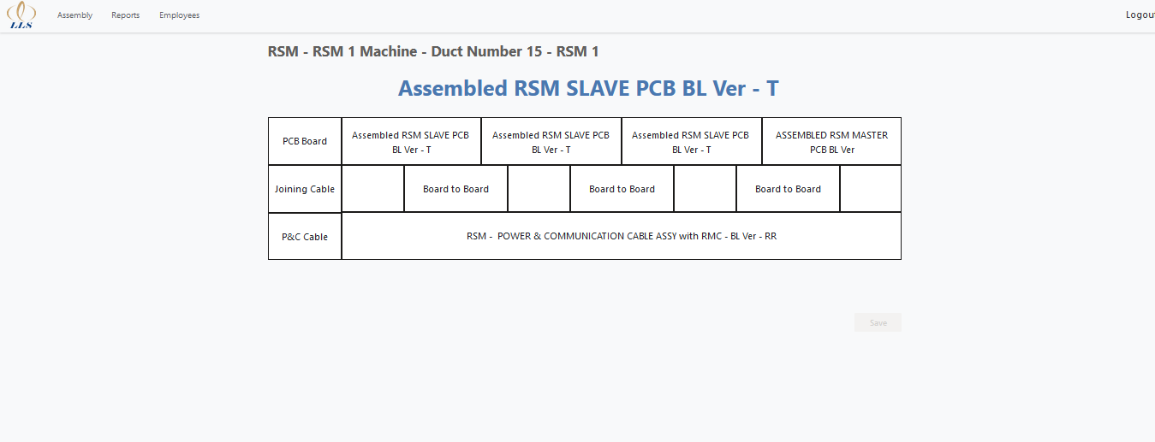
Existing screen & Flow
Assembly scanning screen RSM

Slide 19
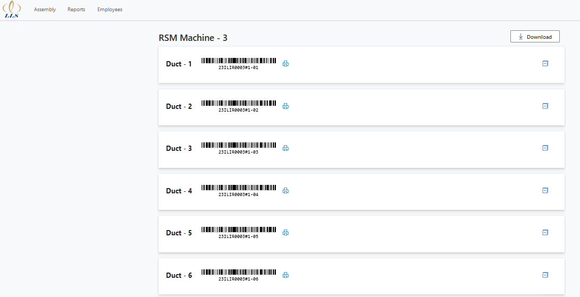
Existing screen & Flow
Remaining all the pages remains same like YBS

Slide 20
Thank You

